Slide 1
MATLAB Programming 2020 Spring
Final Exam One
Instructor: 黃世強 (Sai-Keung Wong)

Slide 2
Content
There are two problems. You must answer all of them.
Write a program to solve each problem. The program must be interactive. You can press keys to generate key events for your program to handle.
You can create new files for functions.
If there are templates, you can use them.

Slide 3
About demo video and demo programs.
A demo video or a demo program may have bugs. They show or illustrate roughly the results. These results may not be exactly the same as the requirements stated in the instruction. They are for your own reference and you do not need to refer to them.
You must follow the instruction to finish your programs.

Slide 4
Program file name format
Write all your programs in a folder. The folder name is mat_exam_01_student_ID. For example, if your ID is 12345678, the folder name is mat_exam_01_12345678.
Zip the folder and upload it.
Write a program for each problem in one file.
The file name is ex01_X_yourStudentID.m, where X is the problem number.
For example, if your student ID is 12345678 and the problem number is 3, then the file name must be ex01_3_12345678.m.
You must not output all the intermediate results.
Output the results that are required only.

Slide 5
File content header
At the top of the file, write down your name, ID, email address, department, and date. If you do not do so, you receive a score of zero in the corresponding problem.
%%%%%%%%%%%%%%%%%%%%%%%%%%%
% Final Exam Number: …
% Problem number: …
% Student Name: …
% Student ID: …
% Email address: …
% Department:
% Date: ….
%%%%%%%%%%%%%%%%%%%%%%%%%%%%

Slide 6
File content
For each problem, display the problem number before showing the results.
close all; clear; clc; % close all windows
% clear variables, and clear screen
disp(‘Final Exam Problem 1.1') % show Final Exam Problem 1.1

Slide 7
(40%) Problem 1.1. A simple interactive application
Plot y = (a*x²+c*x*sin(x)-11)/(x²-b*x-16).
Determine the singular points, i.e., the x value(s) that makes x²-b*x-16 = 0.
The initial value of b is 15. b should be inside [-30, 30]. a = 1, c = 4.
Plot the graph for y in curve segment(s) with different colors.
The step size of x is 0.005.
Show something that is similar to the demo video.
The range of x is [-20, 20]. The line width is 3.
The range of the figure is set as axis([-20 20 -100 100]).
Press ‘n’ to decrease b by 1. Plot another graph for y. Do not clear the figure.
Press ‘m’ to increase b by 1. Plot another graph for y. Do not clear the figure.
Show b’s value as the title of the figure.
Press ‘c’ to clear all the graphs of the figure.
Press ‘q’ to show the student ID on the console window and then quit the program.

Slide 8
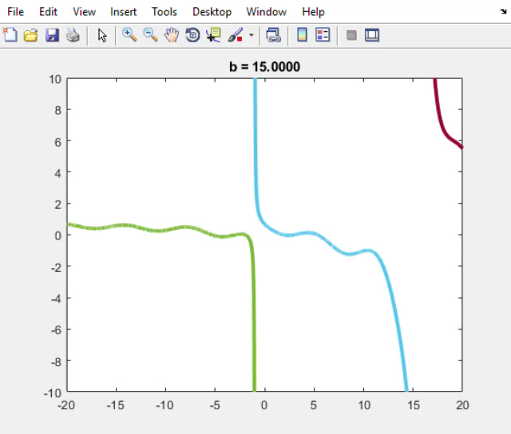
Play to see the demo.
While the program is running,
you can press ‘n’ and ‘m’ to control the value of b.
Press ‘c’ to clear the plots of the figure.
You can press ‘q’ to show the student ID and then quit the program at any time.

Slide 9
(40%) Problem 1.1. Marking Scheme
We do not change the b value in your script but use keys to change it.
[5%] The curve segment(s) are drawn correctly for b = -10.
[5%] The curve segment(s) are drawn correctly for b = -0.
[5%] The curve segment(s) are drawn correctly for b = 15.
[3%] Press ‘n’ to decrease b by 1. The curve segments are correct.
[3%] Press ‘m’ to increase b by 1. The curve segments are correct.
[5%] Show b’s value as the title. b’s value changes when ‘n’ or ‘m’ is pressed.
[3%] Press ‘c’ to clear all the graphs of the figure.
[1%] Press ‘q’ to show the student ID on the console window, close all figure window(s), and then quit the program.
[10%] All the key events are handled correctly and the results are correct.

Slide 10
(60%) Problem 1.2. A simple application with four main options
The following shows the options of the program.
Show the main menu
‘1’ Polar plot
‘2’ Spotlight show
‘3’ Travel with planet
‘4’ Morphing
‘r’ Return to the main menu immediately
‘q’ Quit the program when in the main menu
Press a key to perform the corresponding option.

Slide 11
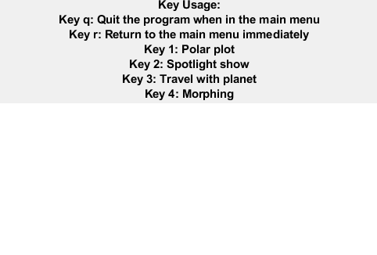
The main menu.
The key usage must be clear.

Slide 12
Problem 1.2. Note. You must implement the following tasks.
While an option is being handled, show the option name and the message “Press r to return”.
While an option is being handled, you can press ‘r’ to return to the main menu or stop the option immediately.
After the option is finished, show the message ‘Press c to continue’. You can do so by setting the message as the title. Press ‘c’ to go back to main menu.

Slide 13
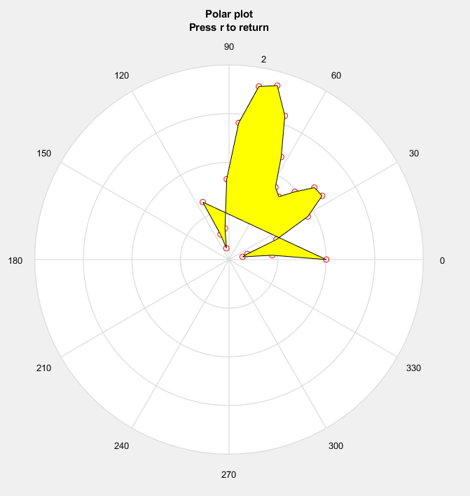
While an option is being handled, you can press ‘r’ to return to the main menu or stop the option immediately.
The process of plotting the curve is stopped immediately when ‘r’ is pressed. You can also return to the main menu when ‘r’ is pressed.

Slide 14
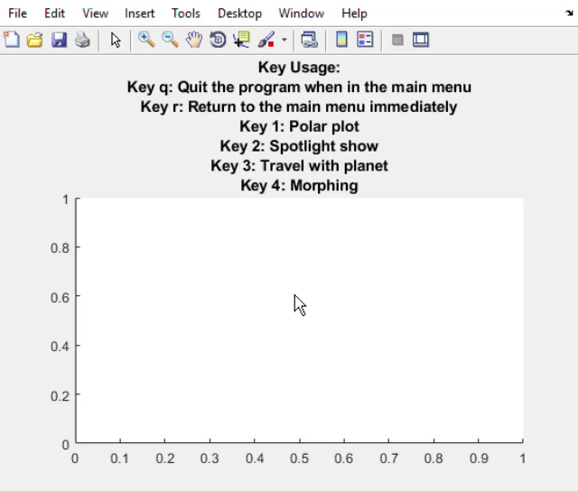
Problem 1.2. Option 1. Polar plot
Interactively plot a curve in the polar coordinate system.
θ changes from 0 to 2π
r = 1 - cos(2 θ) sin(6 θ);
Set the step size of θ properly so that the curve is smooth.
Also, fill the region bounded by the curve interactively. The region is yellow.
The curve color must be visible and different from the region color. Plot a circle at each sample point.
Play to see the animation.

Slide 15
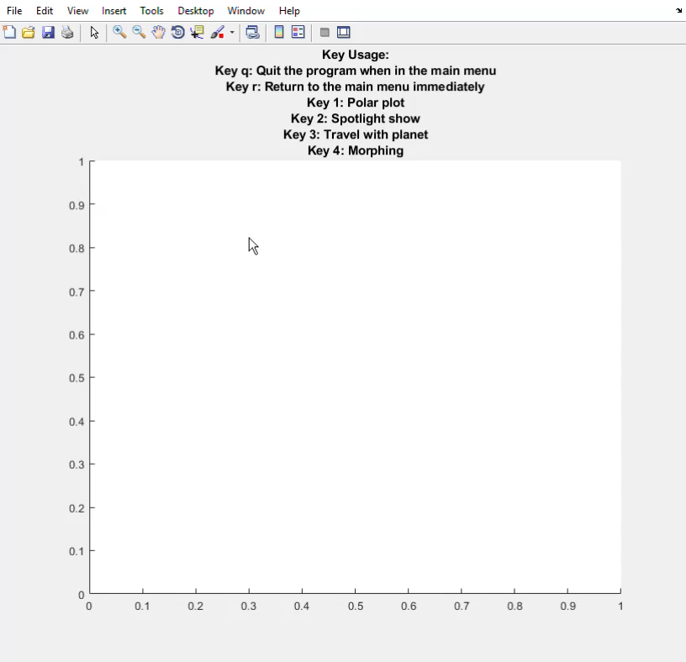
Problem 1.2. Option 2. Spotlight show
Load an image. Resize the image to 640x640.
Rotate a spotlight with two regions (with different intensities). The spotlight makes the affected region of the image brighter. The center region is brighter than the outer region. You rotate the spotlight clockwise or anti-clockwise.
The rotation radius is a half of the width of the image.
Play to see the animation.

Slide 16
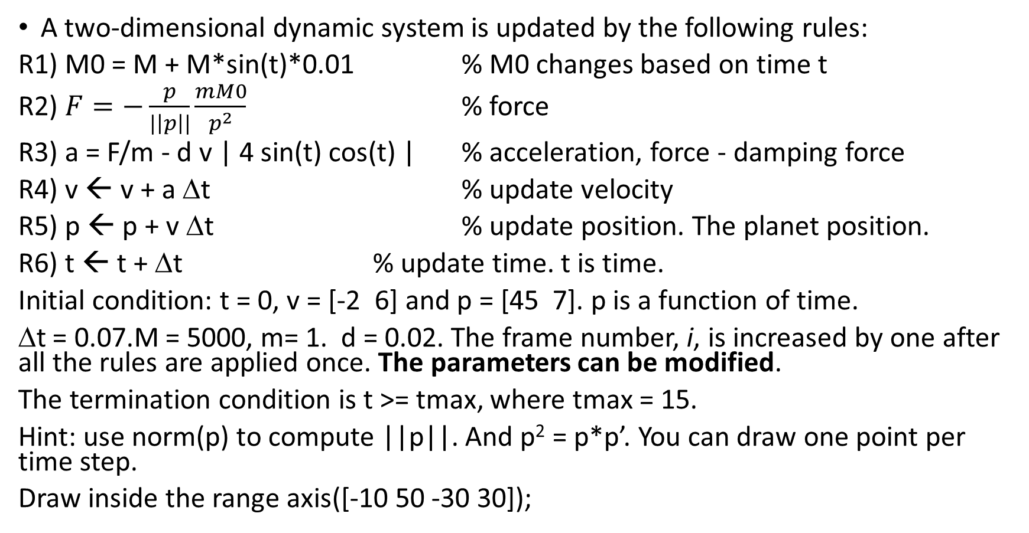
Problem 1.2. Option 3: Travel with planet
A two-dimensional dynamic system is updated by the following rules:
R1) M0 = M + M*sin(t)*0.01 % M0 changes based on time t
R2) $F=−\frac{p}{|\left|p\right||}\frac{mM0}{p^{2}}$ % force
R3) a = F/m - d v | 4 sin(t) cos(t) | % acceleration, force - damping force
R4) v ← v + a Δt % update velocity
R5) p ← p + v Δt % update position. The planet position.
R6) t ← t + Δt % update time. t is time.
Initial condition: t = 0, v = [-2 6] and p = [45 7]. p is a function of time.
Δt = 0.07.M = 5000, m= 1. d = 0.02. The frame number, i, is increased by one after all the rules are applied once. The parameters can be modified.
The termination condition is t >= tmax, where tmax = 15.
Hint: use norm(p) to compute ||p||. And p² = p*p’. You can draw one point per time step.
Draw inside the range axis([-10 50 -30 30]);

Slide 17
Problem 1.2. Option 3
Play to see the animation.
Draw the trajectory of the planet. The planet must be rotating around the origin (0,0) at the beginning.
Draw N recent sample points of the trajectory of the planet.

Slide 18

Problem 1.2. Option 3
Play to see the animation.
Collect the most recent N sample points of the planet trajectory. Compute the length of the curve segment formed by these N points. N must be at least 8.
Plot the estimated average speed vs the frame number, i.
If the length cannot be computed for a small i, the plot is skipped.
Hint:
Assume that the coordinates (x, y) of the sample points are stored in q.
If N = 4, we have
dq = q(i-3:i-1, :) - q(i-2:i,:);
d2 = dq(:,1).*dq(:,1) + dq(:,2).*dq(:,2);
d1 = sqrt(d2);
sd = sum(d1); % total length
sd = sd/(N-1)/dt; % estimated average speed

Slide 19
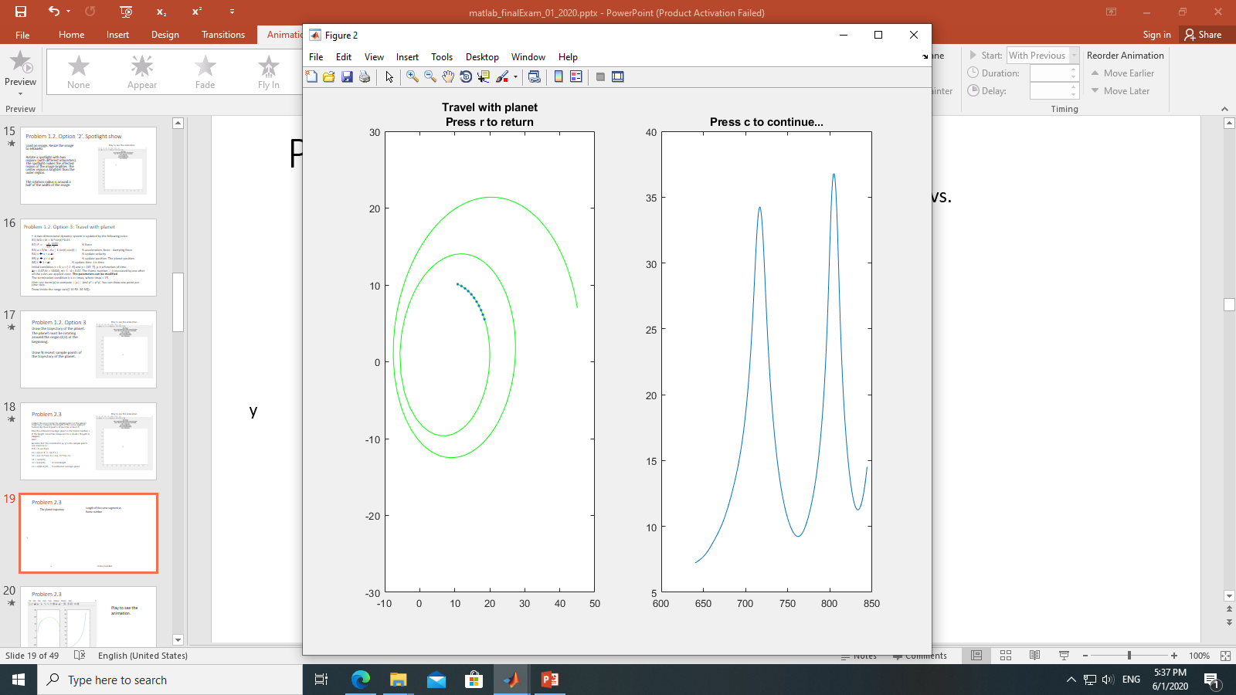
Problem 1.2. Option 3
The planet trajectory
Average speed vs. frame number
y
x
frame number

Slide 20
Problem 1.2. Option 4. Morphing
Given two parametric functions:
Set t = -10:0.025:10. The step size can be adjusted but the curves must be smooth.
We can interpolate the two functions as follows:
x(t) = (1-k) x1(t) + k x2(t)
y(t) = (1-k) y1(t) + k y2(t).
k can be computed in two ways. Thus, we produce the animation by interpolating the two functions in two plots. Let h = 0:0.01:1. The two ways are:
k = 2*h*sin(h*2*pi), and k = sin²(k1*pi), where k1 = 2*h*sin(h*2*pi).
Ask to press ENTER before the animation is generated. The animation result must be similar to the example. There must be two plots (use subplots). Each plot shows one interpolation result. The animation must be smooth and interactive. Make sure that the figure window is on top.
Function 1 x1(t) = a1 * sin( n1*t + c1 ); y1(t) = b1 * cos( t ); a1 = 10; b1 = 5; c1 = 0; n1 = 3; t is the independent variable. | Function 2 x2(t) = a2 * ( 2 cos(t) – cos(5t) ); y2(t) = a2 * ( 2 sin(t) – sin(5t) ); a2 = 5;

Slide 21
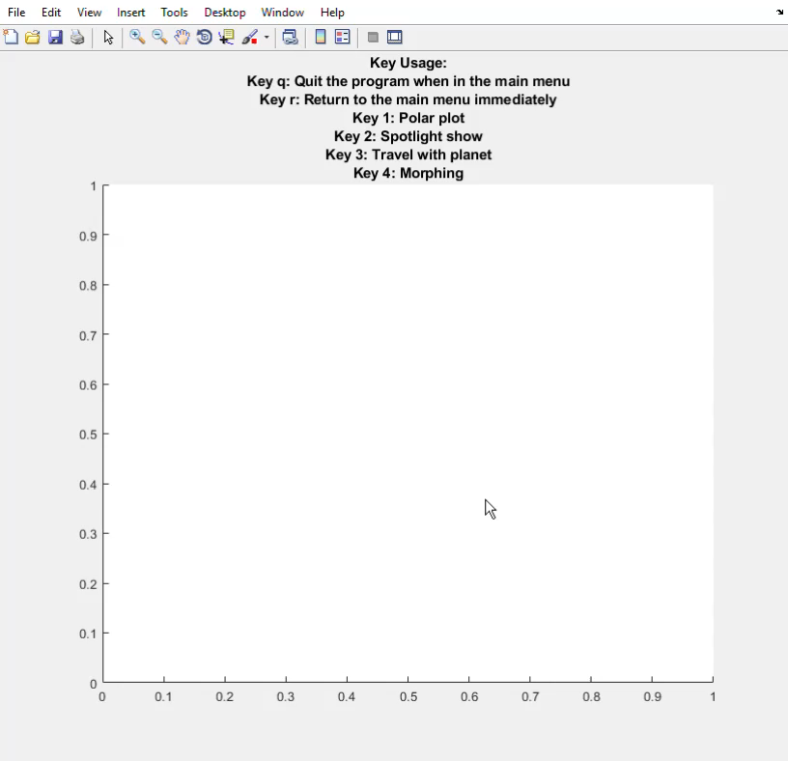
Problem 1.2. Option 4. Morphing
Play to see the animation.

Slide 22
(60%) Problem 1.2. Marking Scheme
(5%) Option 1: the animation is correct.
(5%) Option 2: the animation is correct.
(5%) Option 3: the animation is correct.
(5%) Option 4: the animation is correct.
(5%) Show the main menu.
(5%) Handle all the key events correctly in options 1 and 2.
(5%) Handle all the key events correctly in options 3 and 4.
(4%) Handle at the least 2 options correctly.
(10%) Handle at least 3 options correctly.
(10%) Handle all the four options correctly.
(1%) Press ‘q’ to show student ID, close all figure windows, and then quit the program.

Slide 23
End
Enjoy MATLAB Programming.

